Slide 1


AMAZON SALES ANALYSIS
PRESENTED BY - NITU ALAM

Slide 2





INTRODUCTION
Sales management has gained importance to meet increasing competition and the need for improved methods of distribution to reduce costs and increase profits. Sales management today is the most important function in a commercial and business enterprise.
Sales analytics is the method by which sales data is collected and analyzed to improve sales performance and increase revenue.

Slide 3

PROBLEM STATEMENT
Have to conduct a detailed year-wise analysis of Amazon sales data to understand sales trends by identifying key metrics and other factors and show the meaningful relationship between attributes.

Slide 4
Main KPIsn
Total Revenue
Total Cost
Quantity Sold
Total Profit

Slide 5
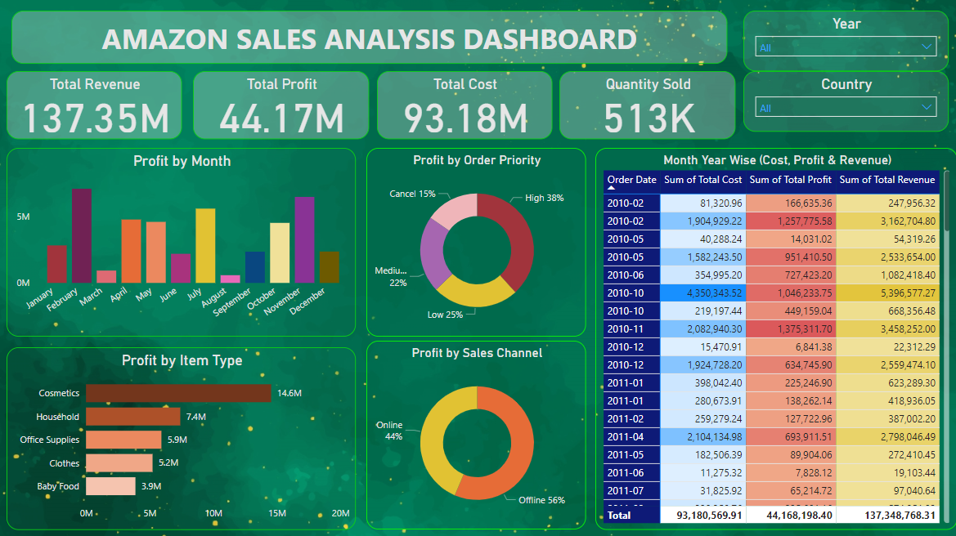
MY DASHBOARD

Slide 6
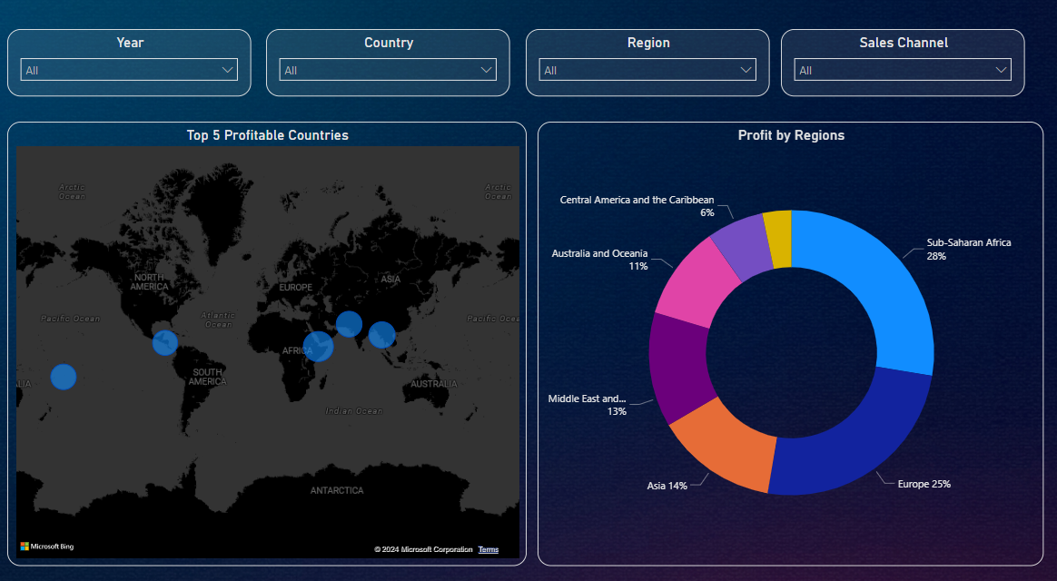
MY DASHBOARD

Slide 7
INSIGHTS GENERATED
Top 5 Gross Profit Margin Categories:
Cosmetics, Households, Office Supplies, Clothes,
and Baby Food are the top-performing categories in
terms of gross profit margin.
Profit Percentage by Sales Channels:
Online sales contribute to 44% of the total profit,
while offline sales contribute to the remaining 56%
Profit Percentage by Customer Preferences:
High-priority customer preferences generate 38%
of the total profit, followed by the least priority
(25%), medium (22%), and cancels (15%).

Slide 8
INSIGHTS GENERATED
Monthly Trends:
February, July, and November exhibit the highest number of
orders, while March, June, and August show the Lowest order volumes.
Profit Percentage by Regions:
Europe and Sub-Saharan Africa are the most profitable regions, contributing 25% and 28% respectively to the total profit. Other significant regions include Asia (14%), Australia and Oceania (11%), Central America and the Caribbean (6%), and Middle East & North America (13%).
Most Profitable Countries:
Djibouti and Myanmar emerge as the most profitable countries within the regions analyzed.

Slide 9
THANK YOU!

